Slide 1
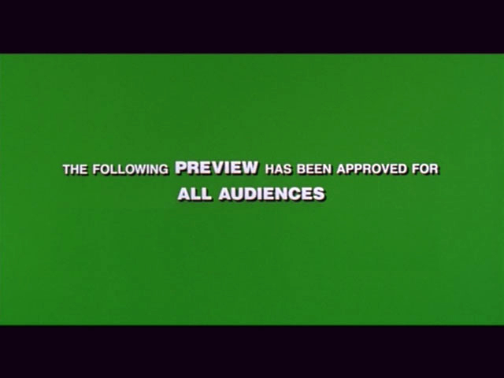
LON-CAPA 3.0
Sneak Preview
Gerd Kortemeyer
April 2011

Slide 2
Overview
Guiding ideas for new release
Things already (almost) working
Things to be done
Questions

Slide 3
Guiding ideas for new release
Two design ideas:
Idea 1: Move basic course management to the foreground
Idea 2: “Flight Management”

Slide 4
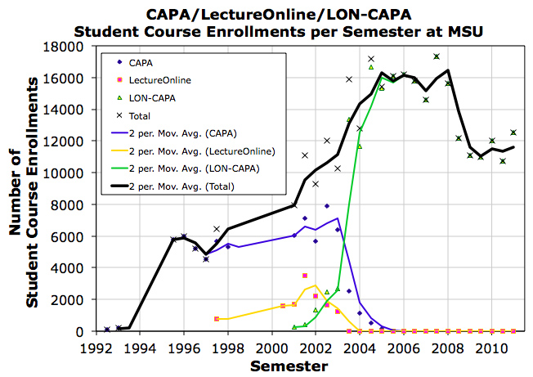
Idea 1 - Background
History: CAPA started as a pure assessment system
  Course Management added later
  Currently still reflected in the interface
9900 individual students
1/4th of MSU’s undergraduate population actively uses LON-CAPA

Slide 5
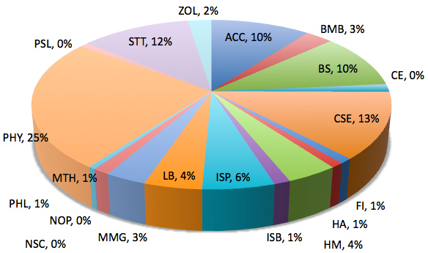
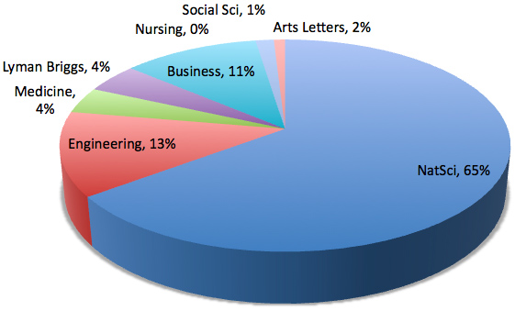
Idea 1 - Background
Used to be just natural science
  Not anymore
Requirements
beyond
geeky homework
Bring basic course management up front

Slide 6
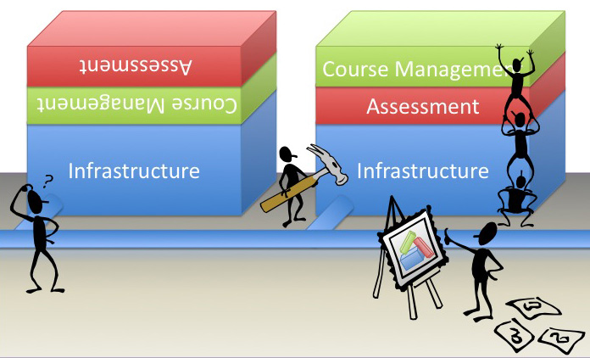
Idea 1 - Design

Slide 7
Idea 2 - Background
More features than most systems
… but faculty don’t know about them
  Enormous number of parameters, settings, configurations … sometimes hard to keep track – “Discoverability”
Very powerful system:
“We make the scissors, you do the running.”
  Move to the foreground what is important at the time when it’s needed

Slide 8
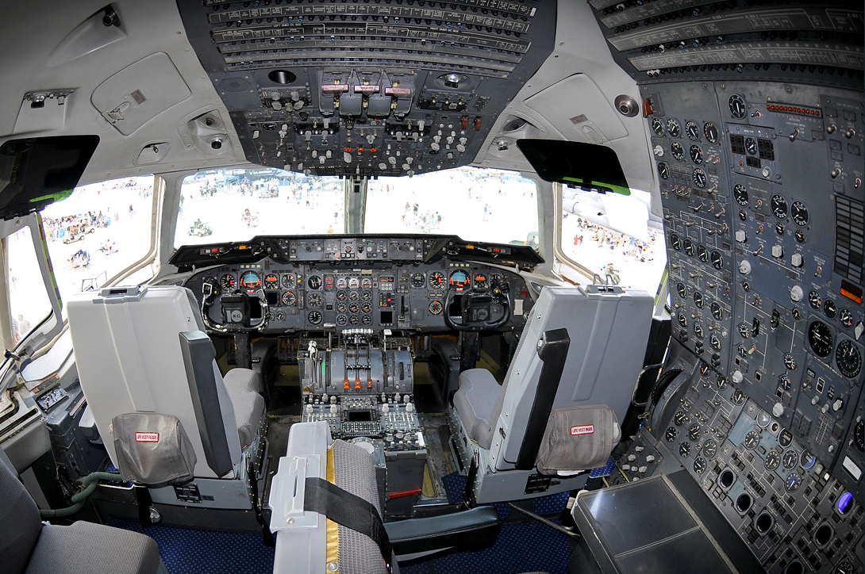
Idea 2 - Background
DC 10

Slide 9
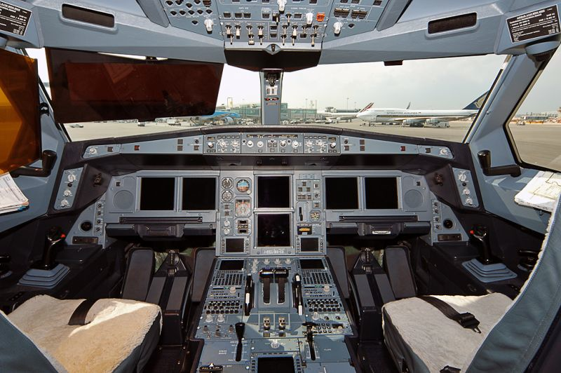
Idea 2 - Design
Airbus

Slide 10
Idea 2 - Design
“Flight Management”
What you need when you need it
2.9
2.10
3.0

Slide 11





Who is or will be working on that?
MSU:
  “Flight management”
  Grading
  Overall coordination
Ostfalia/Wolfenbüttel:
  Design
  Look and feel
  Discoverability
MIT:
  Social networking
  Student support and signaling
Purdue:
  Flight management
  Signaling
UIUC
  Hiring additional programmer

Slide 12



… with input by

Slide 13
Things already (almost) working
In the developer version of LON-CAPA, several of these concepts have already been implemented
Still need
  finishing touches
  testing
… but they will be
in 3.0 for sure

Slide 14
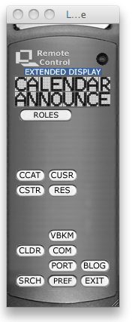

Menus
The “old” LON-CAPA
Remote Control
RIP

Slide 15
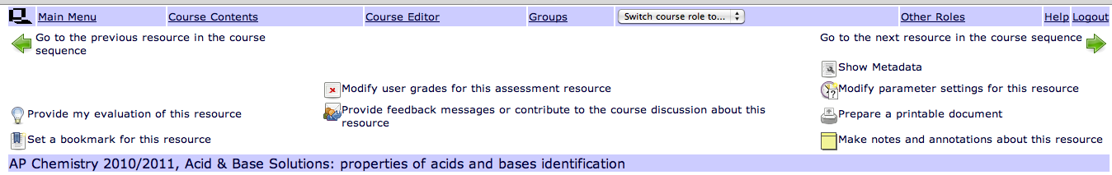
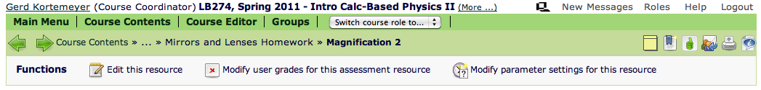
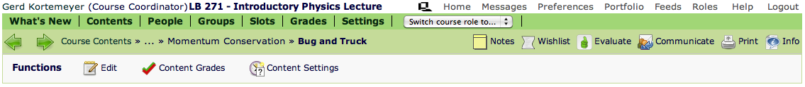
Menus
2.9
2.10
3.0

Slide 16
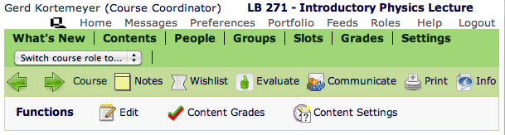
Menus
Clear contexts
Consistent positions
Always
Course
Content
Homework

Slide 17
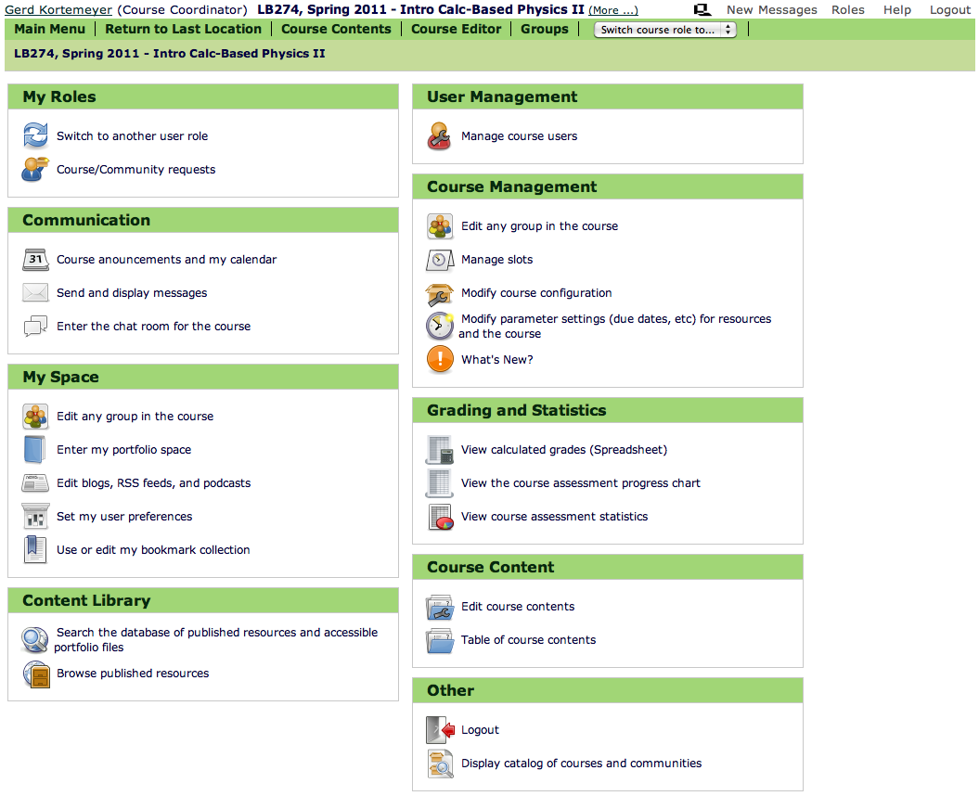
Menus
2.10
Main
Menu

Slide 18
Menus
3.0 Hierarchical Menu
Action-oriented top-level
Standard course management actions

Slide 19
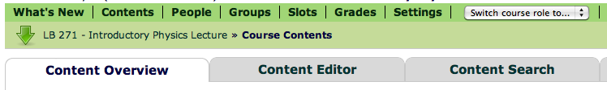
Menus
3.0 Hierarchical Menu
Next level tabs
Should be intuitive for “old” users
Less learning curve for new users
Less clicks

Slide 20
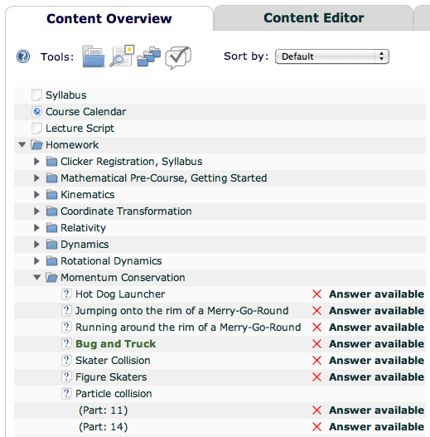
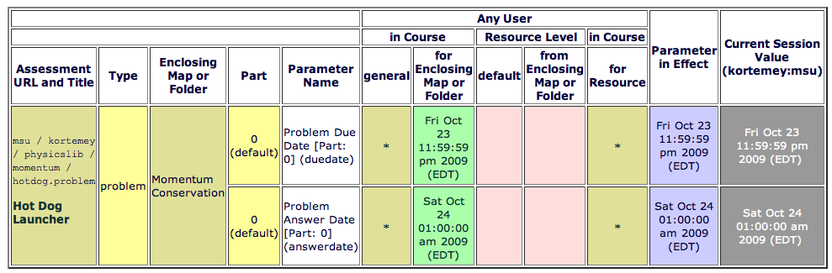
Contextualization
“Flight Management”
Items and messages clickable
Clickable
Direct jump to modification interface

Slide 21

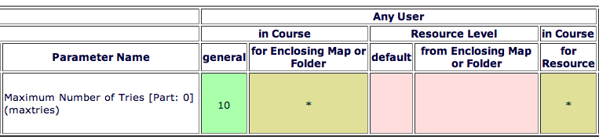
Contextualization
click
… of course depends on the privileges of the user

Slide 22
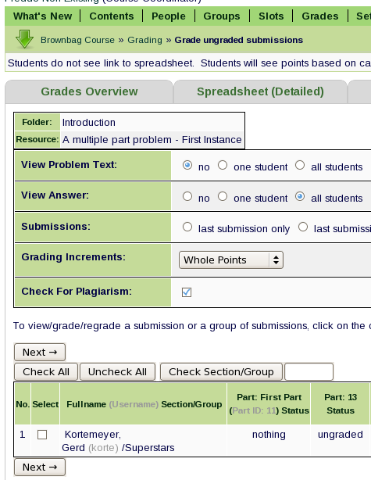
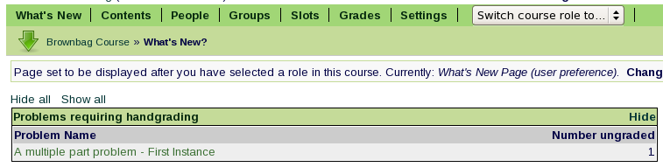
Contextualization
What’s New screen
  Essays and
  drop boxes
click and
grade

Slide 23
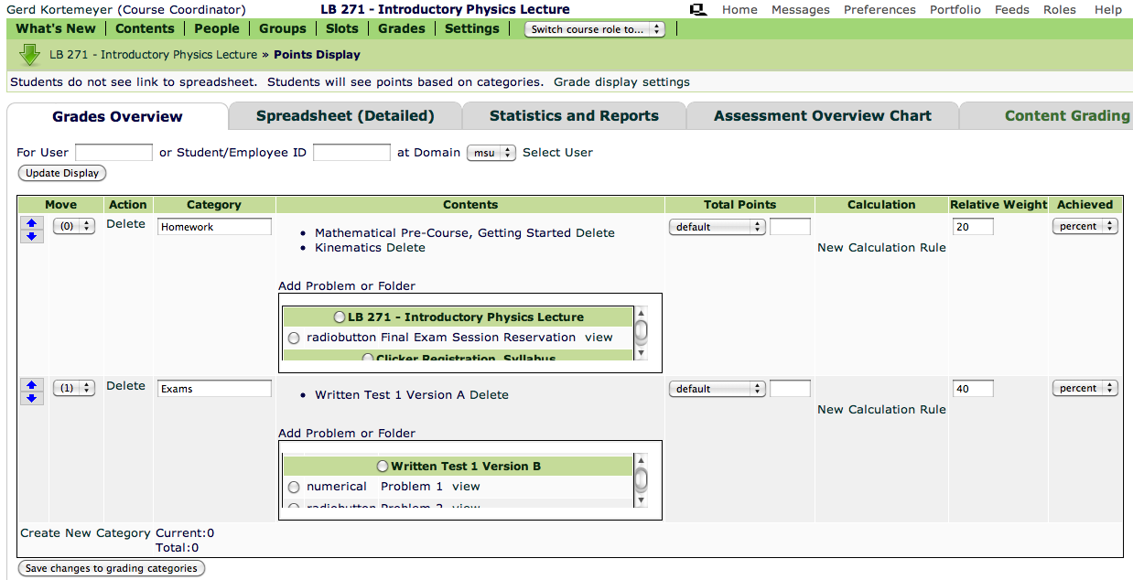
Grading
Category-based grading mode added

Slide 24
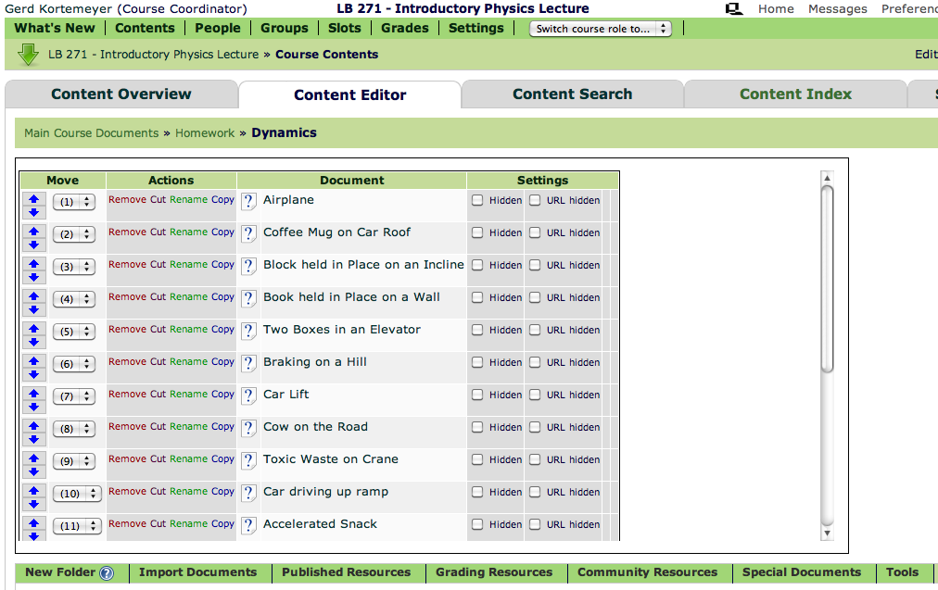
Content Editor
Less scrolling and clearer categories on Content Editor

Slide 25
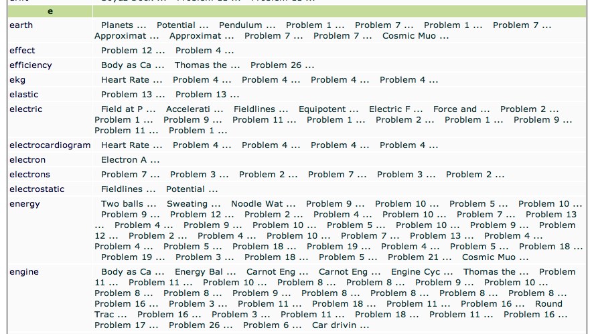
Navigation
New automatically generated index

Slide 26
… and yes, homework …
We could not have a new release without some enhancements to homework
Dynamic graphing

Slide 27
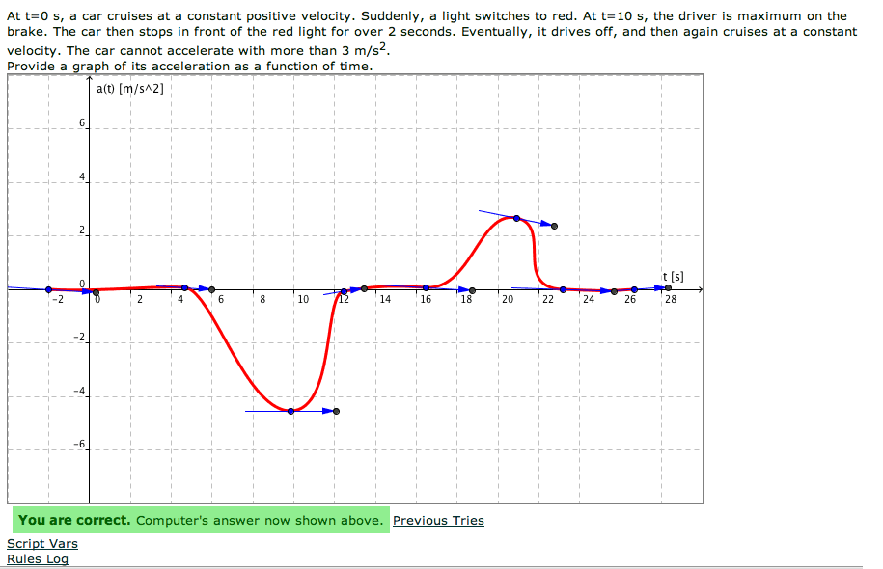
Homework

Slide 28
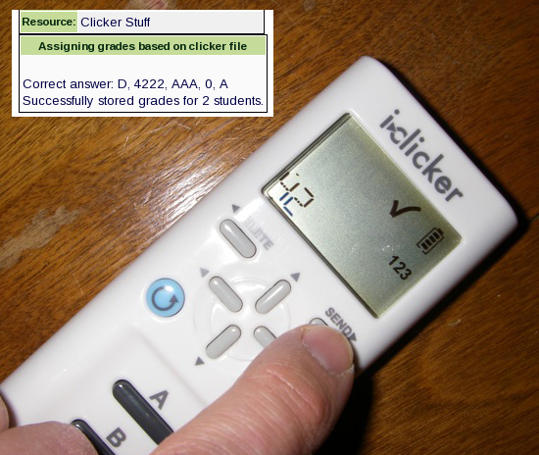
i>Clicker2
Fully compatible with numerical and alphanumeric input of i>Clicker2

Slide 29
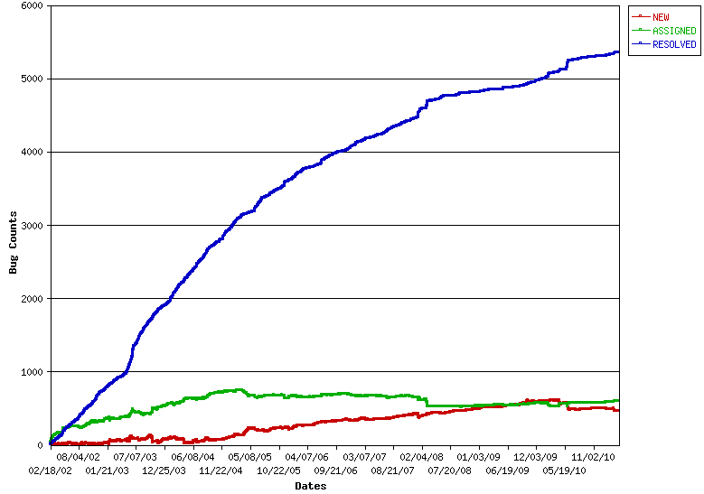
And always:
Bugs and enhancements
Actually catching up!

Slide 30
Things to be done
Things that are still left to do
Currently in concept stage
Warning: going from actual screen shots to mockups

Slide 31
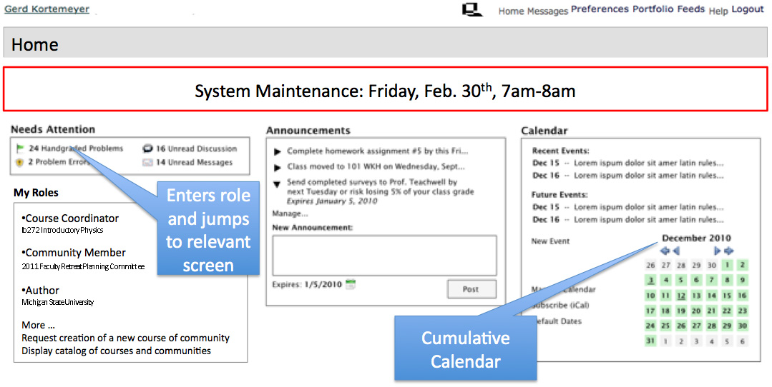
New Home Screen
Home screen shows what is going on across courses, communities, …
Replaces Roles screen

Slide 32
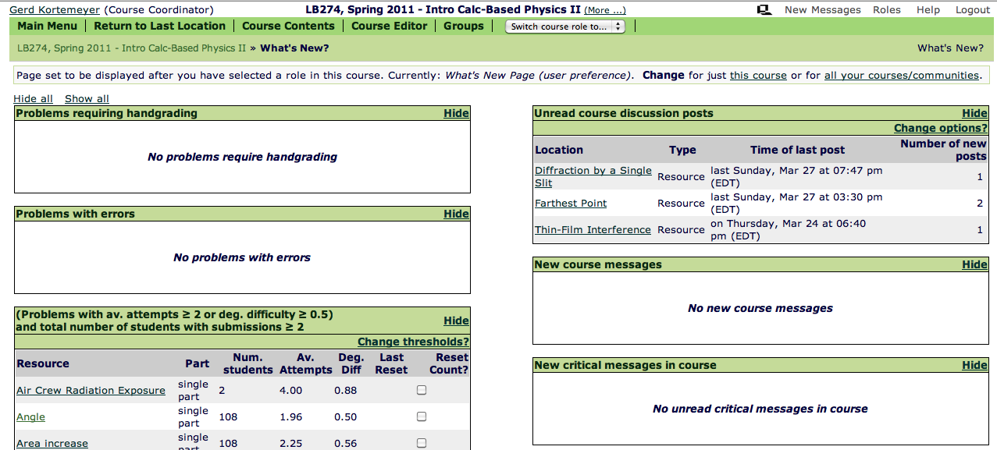
New What’s New
“Flight management”
Will be available for all users in all roles

Slide 33
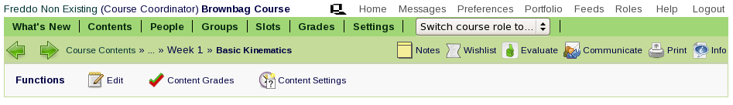
New Contextualization
“Flight management”
Display pertinent information when needed
!
High degree of difficulty
Generally: Open Change
Not open for section 003 Change
Generally: Due May 17, 2010 Change
4 Messages regarding this problem Read
Extend due date
Increase maximum number of tries

Slide 34
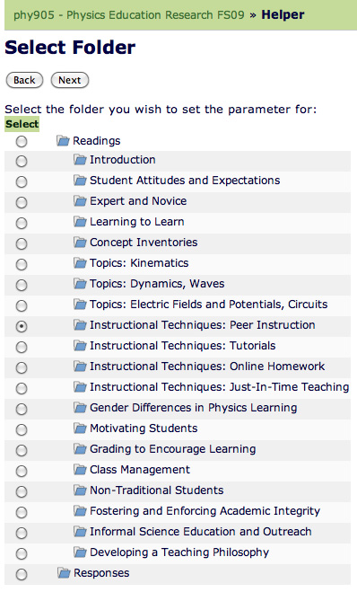
New Helpers
More helpers to accomplish tasks
“I want to turn this folder into an exam”
  hiding
  dates
  exam mode
  etc

Slide 35
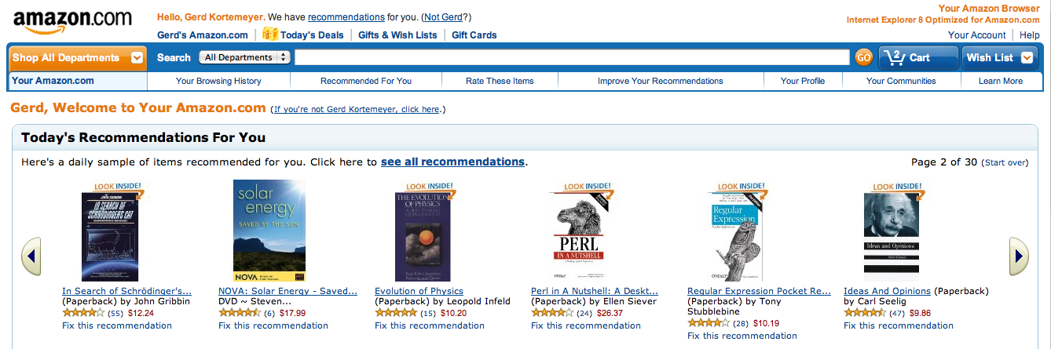
New Search
Recommender system based on dynamic metadata
Shopping cart metaphor for importing resources

Slide 36
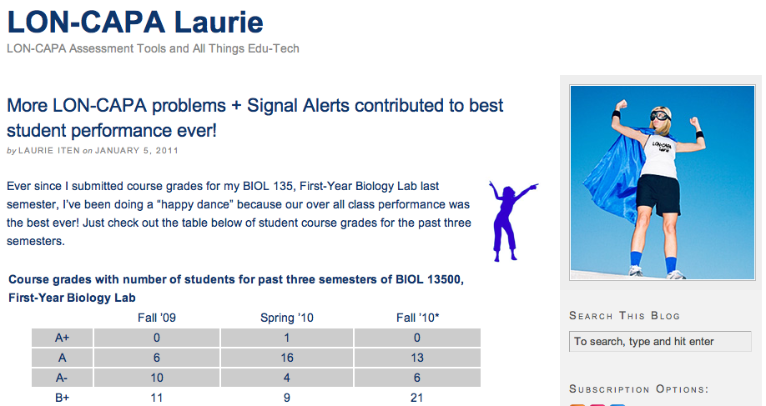
New Alerts
Integrate Purdue’s alert system for students-at-risk into LON-CAPA

Slide 37
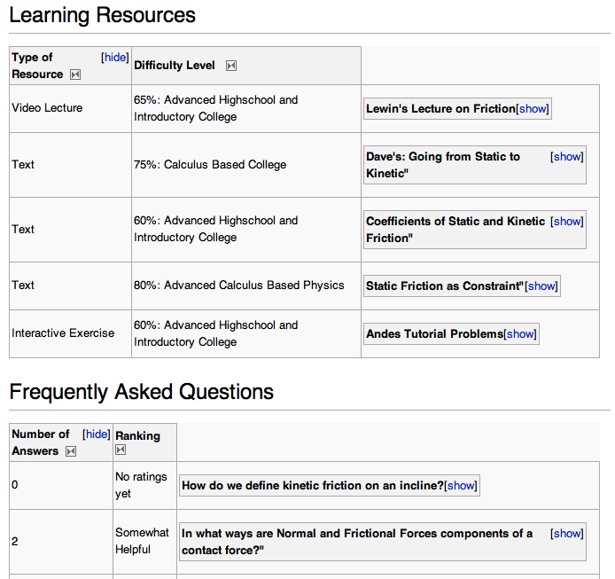
New Learner
Resources
Content “Assets”
  FAQ
  Recommended resources

Slide 38
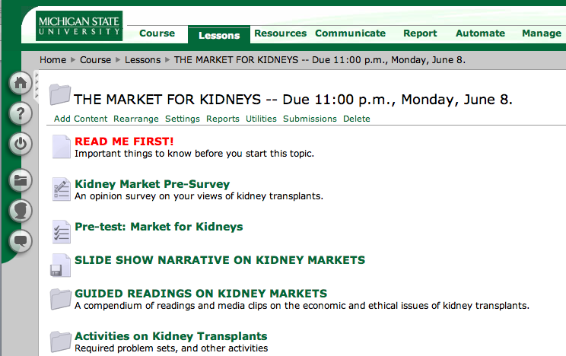
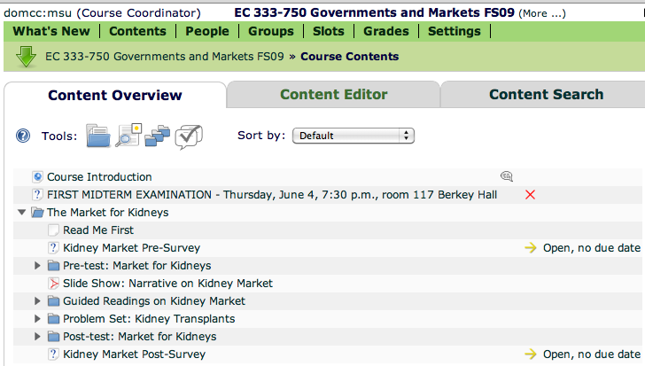
New Import Tools
Automated ANGEL import

Slide 39
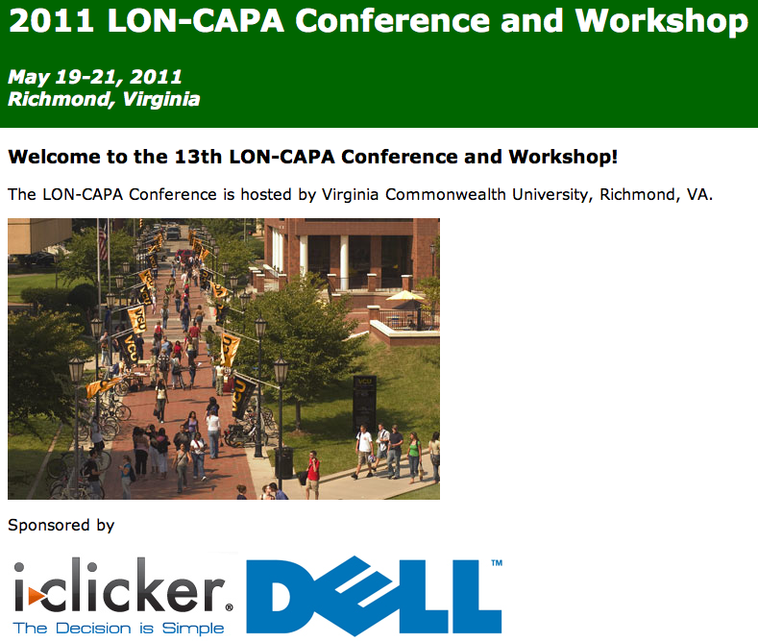
More on this

Slide 40
Thank you!
Questions and maybe answers?
Gerd Kortemeyer
kortemey@msu.edu
http://www.lon-capa.org/

